Slide 1
PIP4004 - INTERNSHIP Review-0 Presentation Project Title: Design of a Privacy-preserving Mobile Wallet for Self Sovereign Identity Management
Student Details
Name | DYAMALLI K
Roll No | 20211CBC0046
Section | 8CBC-01
Batch No. | 9
Under the Supervision of,
Ms. Arshiya Lubna
Assistant Professor
School of Computer Science and Engineering
Presidency University
Name of the Program: CSE(BLOCKCHAIN)
Name of the HoD: Dr.Pravintha Raja
Name of the Program Project Coordinator: Ms. Suma NG
Name of the School Internship/Project Coordinators: Mr. Md Ziaur Rahman /
Dr. Sampath A K / Dr. Abdul Khadar A

Slide 2
Content
About Company or Organization
Working domain or the technology
About your team and reporting Manager
Challenges Faced in Internship
Objectives of the work
Internship Roadmap
Github Link

Slide 3
About Company or Organization
1. About the Company
RECTOPAGE Company
Founded in 2015
Headquartered in Bengaluru, India
Specializes in mobile and web application development
Over a decade of experience in the tech industry
2. Mission & Vision
Mission: Drive change through technology and innovation
Vision: Improve lives and businesses with progressive and innovative tech solutions

Slide 4
3. Key Achievements
Delivered numerous products
Served happy clients worldwide
Won multiple industry awards
Provided professional training to individuals in mobile and web app development
4. Products & Services
Web Applications – Custom full-stack applications
Mobile Applications – Native (Android/iOS) and Hybrid apps
Corporate Training – Training on trending tech topics

Slide 5
5. Clients & Market Presence
Global clientele across multiple industries
Worked on projects like Easy Gadgets, Art Circles, Photos to Art, Switch Art, Nexxus Engage, iQview, My Bills, Xfinity, Oscar, and Screen Bee
6. Contact Information
📧 Email: contact@rectopage.com
📞 Phone: +91 8073429502
📍 Address: #21 A, Krishna County Layout, Near Global Village Tech Park Front Gate, Bengaluru - 560068
🌐 Website: rectopage.com

Slide 6
Working domain or the technology
Working Domain : Web 3
Technology : React Native/Node JS

Slide 7
About your team and reporting Manager
Dr. Manoj Kumar
Principal Consultant at Recto Page
Expertise: Blockchain, Security, Identity Management
Role in this project: Guidance, strategy, and technical validation.
Team Composition:
Lead Developer: Mohit
Blockchain Engineer: Avinash
Mobile App Developer: Prachi
Security Expert: Manoj
Early-stage Responsibilities:
Research: Feasibility study, technology selection
Design: Initial system architecture and user flows

Slide 8
Challenges Faced in Internship
Finding an Internship: Competitive selection process
Cracking the Interview: Technical and HR rounds required extensive preparation
Adjusting to the Team: Adapting to company culture and collaboration dynamics
Learning Curve: Understanding blockchain, decentralized identity, and new tech stacks
Project Execution: Debugging, testing, and integrating various components efficiently

Slide 9
Litereture Survey
S.NO | Title | AUTHOR(S) | Year | Inference
1. | BLS-MT-ZKP: A Novel Approach to Selective Disclosure of Claims | Šeila Bećirović Ramić , | 2024 | Combines BLS signatures, Merkle Trees, and ZKP to enable privacy-preserving claim verification.
2. | A Self-Sovereign Identity Based on Zero-Knowledge Proof and Distributed Ledger Technology | Mohameden Dieye, Pierre Valiorgue, Jean-Patrick Gelas | 2023 | Proposes a blockchain-based SSI model using ZKP for identity authentication while preserving privacy.

Slide 10
S.NO | Title | Author(s) | Year | Inference
3. | Sign Up Wallet: A Blockchain and Machine Learning based Self-Sovereign Identity Model for Enhanced Digital Security. | Rani K, Vishnu Gomathi Sankar S, Vijay C | 2024 | Proposes a blockchain and ML-based identity wallet for enhanced digital security and fraud prevention.
4. | Designing Privacy-Preserving User Interfaces for SSI Wallets on Mobile Devices. | Moritz Teuschel, Daniela Pöhn. | 2024 | Focuses on user interface design for mobile SSI wallets with privacy-preserving features.
5. | A Taxonomy of Challenges for Self-Sovereign Identity Systems | Abylay Satybaldy, Md. SadekMariusz Nowostawski Ferdous. | 2024 | Identifies challenges in SSI, such as interoperability, scalability, and privacy concerns.
6. | A Self-Sovereign Identity Protocol With Anonymity and Accountability | Le Gao, Jiaxin Yu, Junzhe Zhang | 2024 | Introduces a balance between user anonymity and accountability in identity systems using ZKP.

Slide 11
Objectives of the work
To design a decentralized mobile wallet for managing Self-Sovereign Identity (SSI) securely.
To ensure privacy-preserving identity management using zero-knowledge proofs (ZKP) and selective disclosure mechanisms.
To provide a scalable and lightweight solution for mobile devices.
To enhance user control over personal identity data while ensuring security.
To integrate on-device authentication and Trust Chain-based verification to prevent identity fraud.

Slide 12
Proposed System / Work
1. System Architecture
Mobile Wallet App (User Interface for identity storage & sharing).
Trust Chain Network (for credential verification).
Issuer Module (Organizations issuing Verifiable Credentials).
Verifier Module (Entities verifying the user’s identity).
Privacy Layer (Implements ZKP and Selective Disclosure).

Slide 13
Proposed System / Work
2.Workflow
1. User Registration: Generates a Decentralized Identifier (DID).
2. Credential Issuance: An issuer grants Verifiable Credentials (VCs) to the wallet.
3. Authentication & Verification: Users authenticate via ZKP-based proof submission.
4. Selective Disclosure: Users share only required attributes for authentication.

Slide 14
Problem Statement
Current SSI solutions do not adequately address privacy concerns. Most trust-based identity wallets lack privacy-preserving mechanisms, exposing sensitive identity data. A lightweight, scalable, and privacy-preserving solution is required to enhance mobile identity management.

Slide 15
System Requirements
2 . Software Requirements
Mobile App: Flutter/React Native for UI.
Trust Chain Integration: Hyperledger Fabric (Smart Contracts).
Cryptographic Libraries: MIRACL for ZKP and Commitment Schemes.
Cloud/Edge Computing: Firebase for optional off-chain storage.
1. Hardware Requirements
Android/iOS smartphone (Samsung S23 Ultra, etc.).
Secure Element (for key storage).

Slide 16

Advantages of Proposed System/Work
Decentralized – Eliminates reliance on centralized identity providers.
Privacy-Preserving – Uses ZKP and selective disclosure to prevent unnecessary data exposure.
Scalable – Works efficiently on mobile devices with lightweight cryptographic computations.
Secure – Reduces identity fraud and replay attacks using a nonce-based commitment scheme.
User Control – Users retain full control over identity data and credential sharing.

Slide 17
Self-Sovereign Identity (SSI) Smart Contract for Skill Credentials
Self-Sovereign Identity (SSI) enables individuals to manage their digital identity without reliance on centralized authorities. It allows users to control, share, and verify credentials in a decentralized manner.
This smart contract is designed to issue and verify skill-based credentials using Decentralized Identifiers (DIDs) and Verifiable Credentials (VCs).
The proposed implementation ensures that skill credentials are issued, stored, and validated on a blockchain network while preserving the principles of decentralization, interoperability, and user control.

Slide 18
System Architecture
The SSI-based skill credential system consists of three primary entities:
Issuer: A trusted entity (e.g., universities, certification authorities) responsible for issuing credentials to holders.
Holder: A user who owns and manages their credentials, linked to their DID.
Verifier: An entity that verifies the validity of credentials without direct communication with the issuer.

Slide 19
The contract manages credential issuance, verification, and revocation with offchain data storage for privacy.
3. Smart Contract Design
3.1 Data Structures
The contract defines a Credential structure that follows the W3C Verifiable Credential model:
struct Credential {
string skill; // Name of the certified skill
string holderDID; // DID of the credential holder
string issuerDID; // DID of the credential issuer
uint256 issuedAt; // Timestamp of issuance
bool revoked; // Revocation status
bytes signature; // Issuer's cryptographic proof
}
Each credential is uniquely identified by a credential ID, computed using a keccak256 hash of its attributes. This ensures uniqueness while enabling efficient verification.

Slide 20
Issuer Authorization
A mapping maintains a list of trusted issuers, ensuring that only verified entities can issue credentials:
mapping(address => bool) public issuers;
modifier onlyIssuer() {
require(issuers[msg.sender], "Not an authorized issuer");
_;
}
Issuers can be added or removed dynamically, providing flexibility for governance and compliance with institutional requirements.

Slide 21
Credential Issuance
The issuance process involves the issuer generating a cryptographic signature and storing only the metadata on-chain:
function issueCredential(
string memory _skill,
string memory _holderDID,
string memory _issuerDID,
bytes memory _signature
) public onlyIssuer returns (bytes32) {

Slide 22
bytes32 credentialId = keccak256(abi.encodePacked(_skill, _holderDID, _issuerDID, block.timestamp));
credentials[credentialId] = Credential({
skill: _skill,
holderDID: _holderDID,
issuerDID: _issuerDID,
issuedAt: block.timestamp,
revoked: false,
signature: _signature
});
emit CredentialIssued(credentialId, _skill, _holderDID, _issuerDID, block.timestamp);
return credentialId;
}
This approach ensures that credentials remain tamper-proof while minimizing on-chain storage costs.

Slide 23
Credential Verification
Verification is performed using ECDSA signature validation, allowing any verifier to confirm the credential’s authenticity:
function verifyCredential(bytes32 _credentialId, address _issuer)
public view returns (bool isValid, bool isRevoked) {
require(credentials[_credentialId].issuedAt != 0, "Credential does not exist");
Credential memory cred = credentials[_credentialId];
bytes32 hash = keccak256(abi.encodePacked(cred.skill, cred.holderDID, cred.issuerDID, cred.issuedAt));
bool validSignature = recoverSigner(hash, cred.signature) == _issuer;
return (validSignature, cred.revoked);
}

Slide 24
function recoverSigner(bytes32 hash, bytes memory signature) internal pure returns (address) {
bytes32 r;
bytes32 s;
uint8 v;
assembly {
r := mload(add(signature, 32))
s := mload(add(signature, 64))
v := byte(0, mload(add(signature, 96)))
}
return ecrecover(hash, v, r, s);
}
The verification mechanism ensures that credentials are validated without relying on the issuer, making the system decentralized and trustless.

Slide 25
Credential Revocation
Credentials can be revoked by the issuer when necessary, such as in cases of credential expiration or policy updates. The revocation status is stored as a Boolean flag:
function revokeCredential(bytes32 _credentialId) public onlyIssuer {
require(credentials[_credentialId].issuedAt != 0, "Credential does not exist");
require(keccak256(abi.encodePacked(credentials[_credentialId].issuerDID)) == keccak256(abi.encodePacked(msg.sender)), "Only the issuer can revoke");
credentials[_credentialId].revoked = true;
emit CredentialRevoked(_credentialId, credentials[_credentialId].issuerDID);
}
Since blockchain data is immutable, the credential itself cannot be deleted, ensuring a transparent audit history.

Slide 26
Implementation Considerations
4.1 Off-Chain Storage Integration
To optimize blockchain efficiency, the credential details can be stored off-chain using InterPlanetary File System (IPFS) or Arweave, while only the credential hash is recorded on-chain.
Example storage strategy:
1. Credential JSON stored on IPFS.
2. IPFS hash (CID) stored in the smart contract for lookup.
3. Holders share their IPFS hash along with the credential ID for verification.

Slide 27
Decentralized Identity Standards
The contract is designed to be compatible with DID standards (e.g., W3C DID, ERC-725, ERC-780) to ensure interoperability with existing decentralized identity ecosystems.
Mobile Device Integration
To enhance usability on mobile devices, the system can be integrated with Samsung Knox for secure key management.
This enables on-device credential storage and signing, enhancing privacy and security in mobile environments.

Slide 28
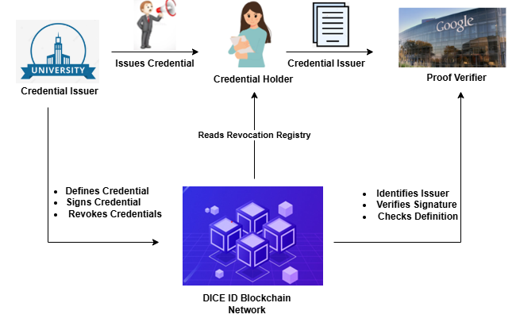
1. Credential Issuer (e.g., University)
Role: Trusted entity that defines and issues credentials (like degrees, certificates).
Responsibilities:
Defines Credential: Specifies what information goes into the credential.
Signs Credential: Digitally signs it to prove authenticity.
Revokes Credentials: Updates the blockchain if a credential becomes invalid.

Slide 29
2. Credential Holder (e.g., Student or User)
Role: Receives and stores credentials from the issuer.
Can Present Credentials: When required, shares proofs of their credentials to verifiers.
Reads Revocation Registry: Checks the blockchain to ensure the credential hasn't been revoked.
3. Proof Verifier (e.g., Employer like Google)
Role: Entity requesting proof of the user's credential.
Responsibilities:
Identifies Issuer: Confirms who issued the credential.
Verifies Signature: Ensures it's genuinely signed by a trusted issuer.
Checks Definition: Makes sure the credential format and content match the expected structure.
4. DICE ID Blockchain Network
Role: A decentralized network that supports identity operations.
Purpose:
Hosts public keys of issuers.
Maintains the revocation registry.
Enables secure verification without needing a central authority.

Slide 30
5.Data Flow Summary
The University (Issuer) creates and signs a credential → gives it to the Credential Holder.
The Holder can show it to a Verifier (e.g., Google).
The Verifier uses the Blockchain to:
Check the issuer’s identity.
Verify the signature.
Confirm it hasn’t been revoked.

Slide 31
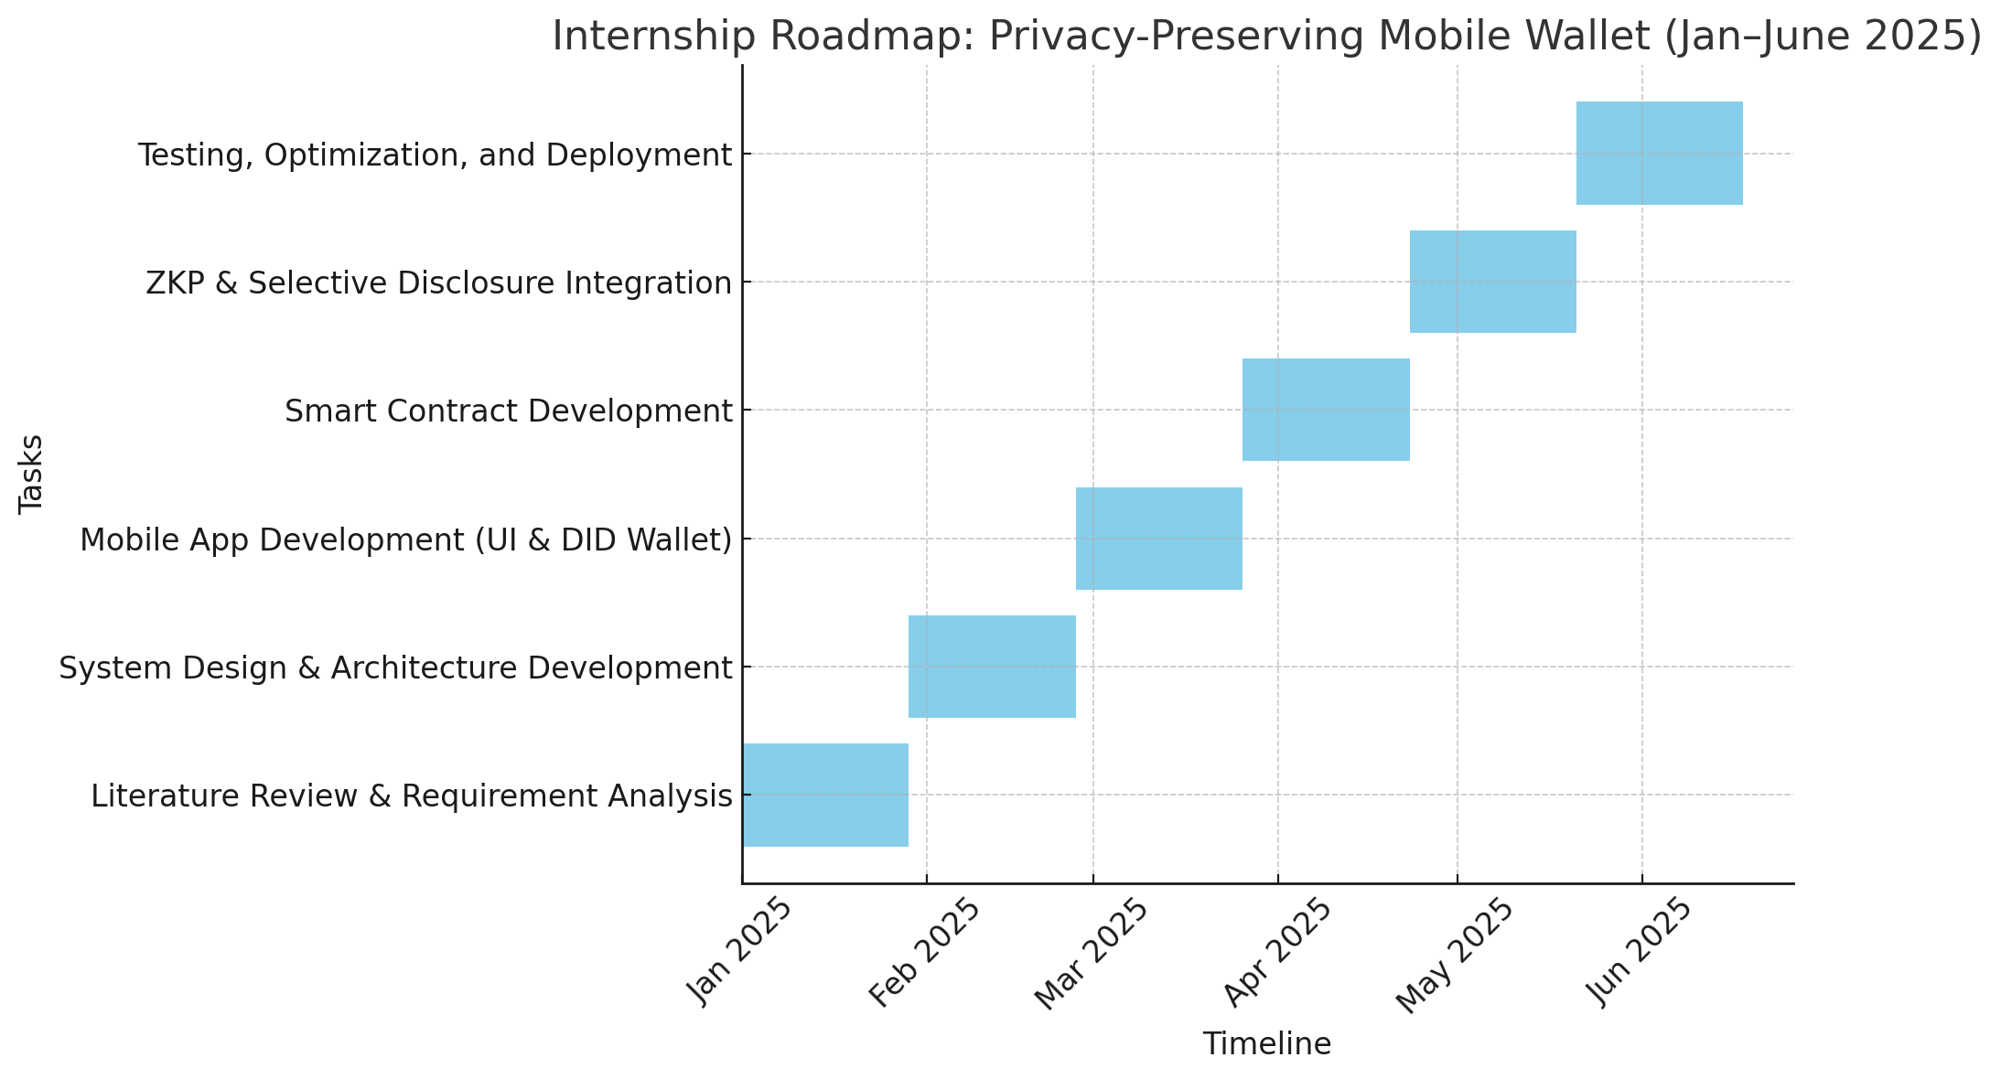
Internship Road Map
Note: Write in the below table what u will be achieving in each review

Slide 32
Github Link
https://github.com/Dyamalli/Privacy-preserving-Mobile-Wallet-for-Self-Sovereign-Identity-Management

Slide 33
Q&A

Slide 34
Thank you !!

